Slide 1

Web Scraping

Slide 2
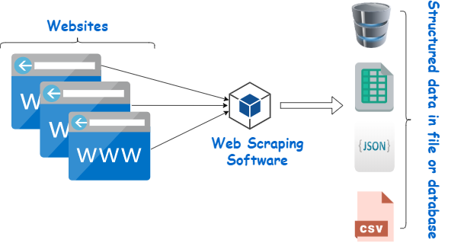
What is web scrapping

Slide 3
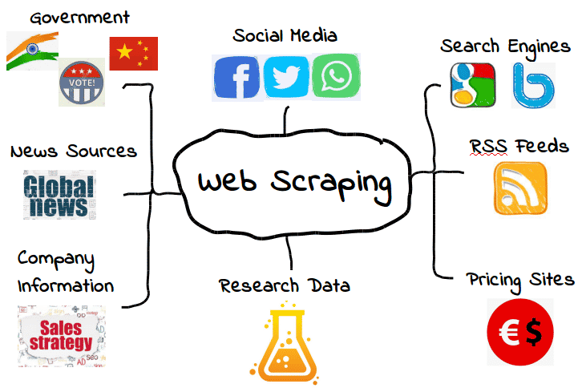

Slide 4
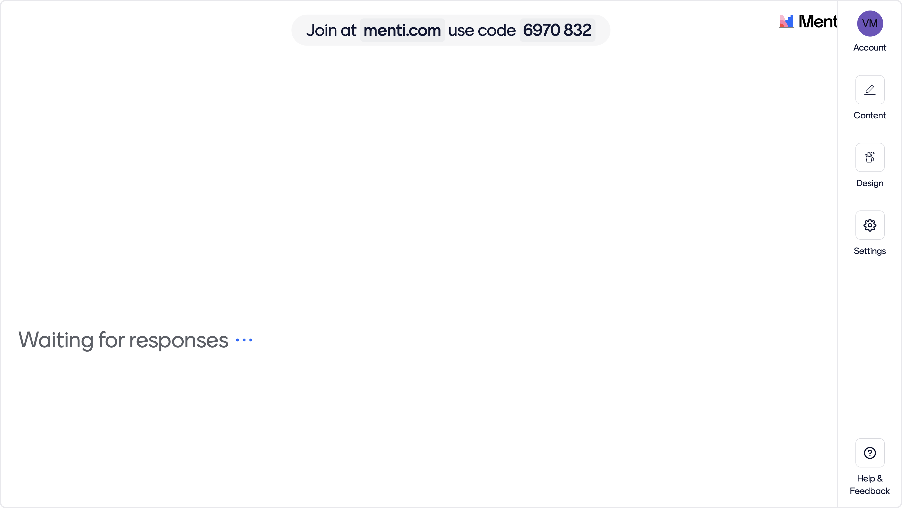

Slide 5


Slide 6
Basic HTML Parsing
from bs4 import BeautifulSoup
# Sample HTML content
html_content = "<html><head><title>My Web Page</title></head><body><p>Hello, World!</p></body></html>"
# Parse the HTML
soup = BeautifulSoup(html_content, "html.parser")
# Print the title tag
print("Title:", soup.title)
# Print the paragraph text
print("Paragraph:", soup.p.text)

Slide 7
Finding Elements by Tag
from bs4 import BeautifulSoup
# Sample HTML content
html_content = "<ul><li>Item 1</li><li>Item 2</li><li>Item 3</li></ul>"
# Parse the HTML
soup = BeautifulSoup(html_content, "html.parser")
# Find all list items
items = soup.find_all("li")
# Print each item
for item in items:
print(item.text)

Slide 8
Finding Elements by Class
from bs4 import BeautifulSoup
# Sample HTML content
html_content = "<div class='container'><p class='text'>Hello, World!</p></div>"
# Parse the HTML
soup = BeautifulSoup(html_content, "html.parser")
# Find the paragraph with class 'text'
paragraph = soup.find("p", class_="text")
# Print the paragraph text
print(paragraph.text)

Slide 9
Finding Elements by ID
from bs4 import BeautifulSoup
# Sample HTML content
html_content = "<div id='content'><p>Hello, World!</p></div>"
# Parse the HTML
soup = BeautifulSoup(html_content, "html.parser")
# Find the div with id 'content'
div = soup.find("div", id="content")
# Print the paragraph text
print(div.p.text)

Slide 10
Navigating the HTML Tree
from bs4 import BeautifulSoup
# Sample HTML content
html_content = "<div><p>Paragraph 1</p><p>Paragraph 2</p></div>"
# Parse the HTML
soup = BeautifulSoup(html_content, "html.parser")
# Navigate the HTML tree
div = soup.div
for p in div.find_all("p"):
print(p.text)

Slide 11
Extracting Attributes
from bs4 import BeautifulSoup
# Sample HTML content
html_content = "<a href='https://example.com'>Visit Example</a>"
# Parse the HTML
soup = BeautifulSoup(html_content, "html.parser")
# Extract the 'href' attribute
link = soup.a
print("Link Text:", link.text)
print("Link URL:", link["href"])

Slide 12
Scraping Tables
from bs4 import BeautifulSoup
# Sample HTML content with a table
html_content = "<table><tr><th>Name</th><th>Age</th></tr><tr><td>Alice</td><td>25</td></tr><tr><td>Bob</td><td>30</td></tr></table>"
# Parse the HTML
soup = BeautifulSoup(html_content, "html.parser")
# Find the table
table = soup.find("table")
# Extract and print table data
for row in table.find_all("tr")[1:]:
columns = row.find_all("td")
name = columns[0].text
age = columns[1].text
print(f"Name: {name}, Age: {age}")

Slide 13
Scraping Images
from bs4 import BeautifulSoup
# Sample HTML content with an image
html_content = "<img src='https://example.com/image.jpg' alt='Sample Image'>"
# Parse the HTML
soup = BeautifulSoup(html_content, "html.parser")
# Find the image
image = soup.img
# Extract and print the image source and alt text
src = image["src"]
alt = image["alt"]
print("Image Source:", src)
print("Image Alt Text:", alt)

Slide 14
Task- scrape indiakanoon website
Start - https://indiankanoon.org/doc/1/
End - https://indiankanoon.org/doc/999989/

